Slide 1


Lecture 24
Produced by Dr. Worldwide
Welcome to the 305
~
~

Slide 2



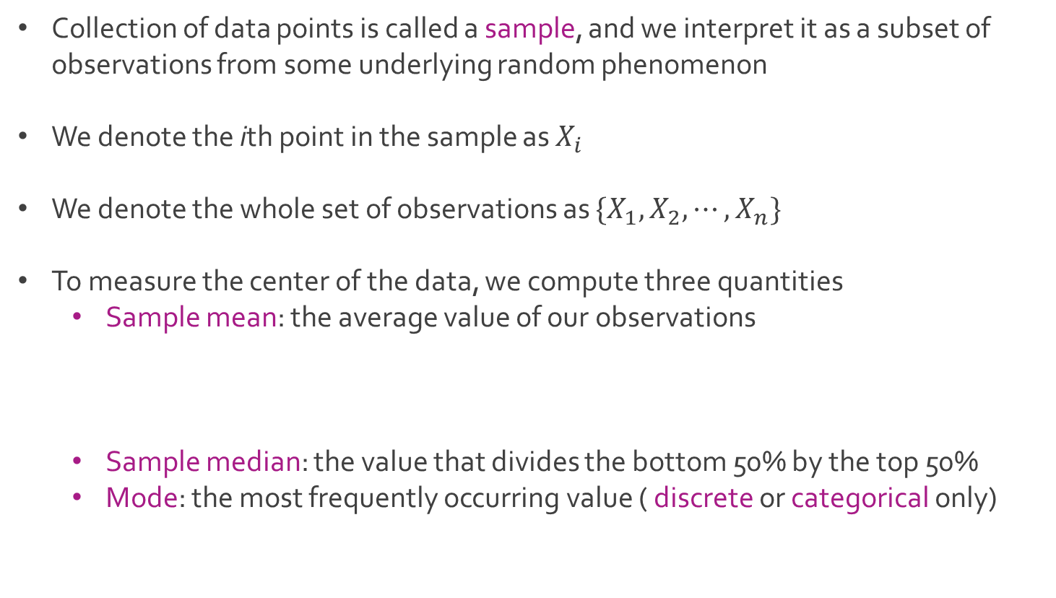
Descriptive Statistics
Collection of data points is called a sample, and we interpret it as a subset of observations from some underlying random phenomenon
We denote the ith point in the sample as $X_{i}$
We denote the whole set of observations as ${\{X}_{1},X_{2}, ⋯, X_{n}\}$
To measure the center of the data, we compute three quantities
Sample mean: the average value of our observations
Sample median: the value that divides the bottom 50% by the top 50%
Mode: the most frequently occurring value ( discrete or categorical only)

Slide 3
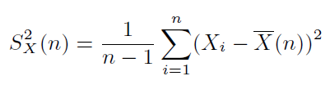
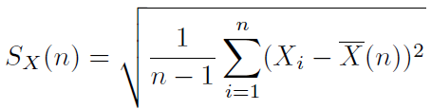
Descriptive Statistics
Q: Why calculate the sample mean and sample median?
To measure the spread of the data, we compute three quantities
Sample variance: the average squared distance between an observation and the sample mean
Sample standard deviation: more convenient than the sample variance
Range: the difference between the largest value and smallest value

Slide 4
Descriptive Statistics
Percentiles are also helpful
The kth percentile is a value that divides the bottom k% from the top (1-k)%
The median is the 50th percentile
The 25th and 75th percentiles (Q1 and Q3) are useful for understanding the variability in the middle of the distribution
The interquartile range (IQR) is the difference between Q3 and Q1

Slide 5
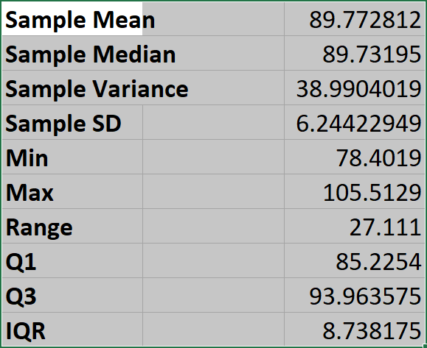
Ex: Starting Salaries
Download Salaries-2.xlsx from link Sheet 1 on course website
Analyze the formulas for these statistics in the Frequency sheet

Slide 6
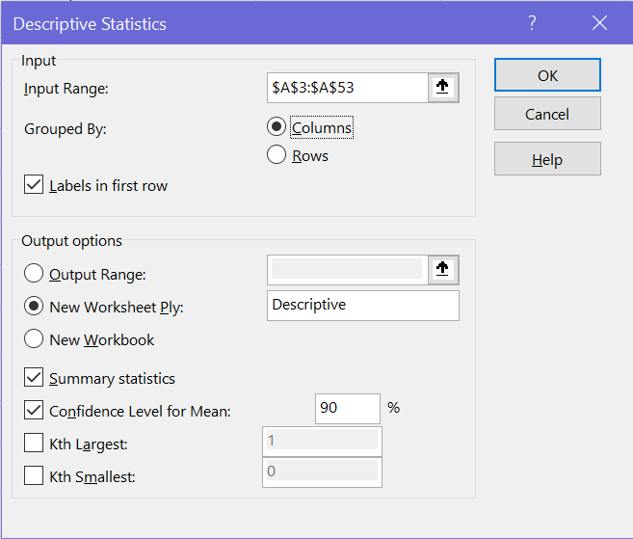
Ex: Starting Salaries
More information can be gathered using Data Analysis in the Data menu

Slide 7
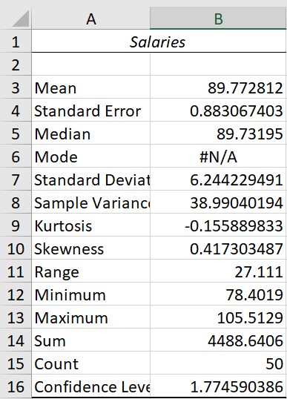
Ex: Starting Salaries
Results from the Analysis ToolPak

Slide 8
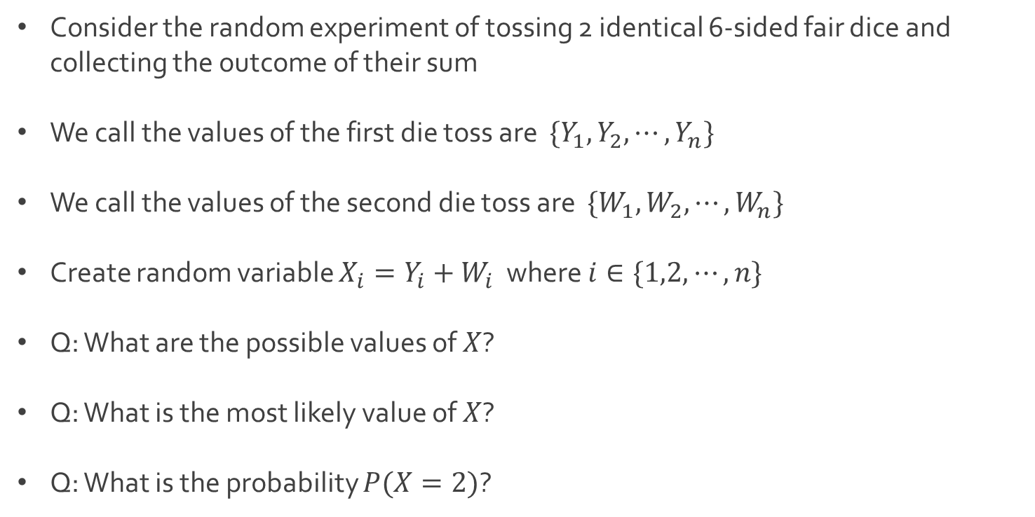
Ex: Sum of Dice
Consider the random experiment of tossing 2 identical 6-sided fair dice and collecting the outcome of their sum
We call the values of the first die toss are $\{Y_{1}, Y_{2}, ⋯,Y_{n}\}$
We call the values of the second die toss are $\{W_{1}, W_{2}, ⋯,W_{n}\}$
Create random variable $X_{i}=Y_{i}+W_{i}$ where $i∈\{1,2,⋯,n\}$
Q: What are the possible values of $X$?
Q: What is the most likely value of $X$?
Q: What is the probability $P(X=2)$?

Slide 9
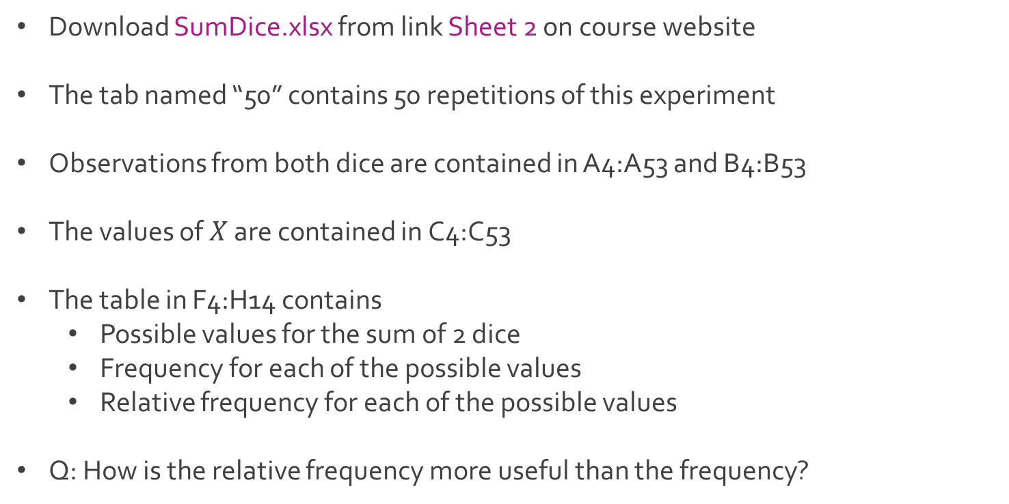
Ex: Sum of Dice
Download SumDice.xlsx from link Sheet 2 on course website
The tab named “50” contains 50 repetitions of this experiment
Observations from both dice are contained in A4:A53 and B4:B53
The values of $X$ are contained in C4:C53
The table in F4:H14 contains
Possible values for the sum of 2 dice
Frequency for each of the possible values
Relative frequency for each of the possible values
Q: How is the relative frequency more useful than the frequency?

Slide 10
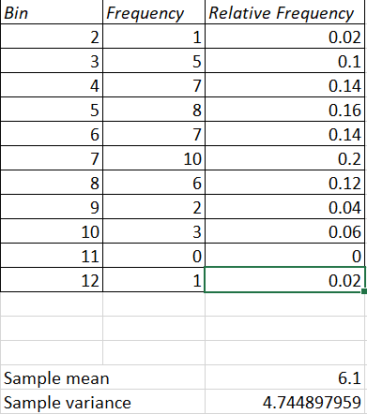
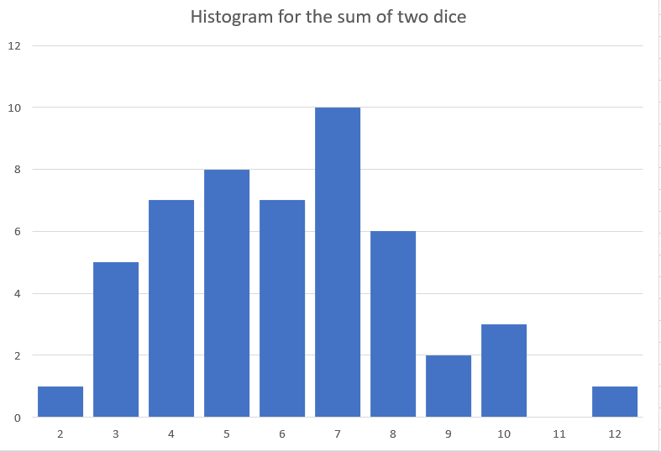
Ex: Sum of Dice
Q: How well do you think this sample represents the population?

Slide 11
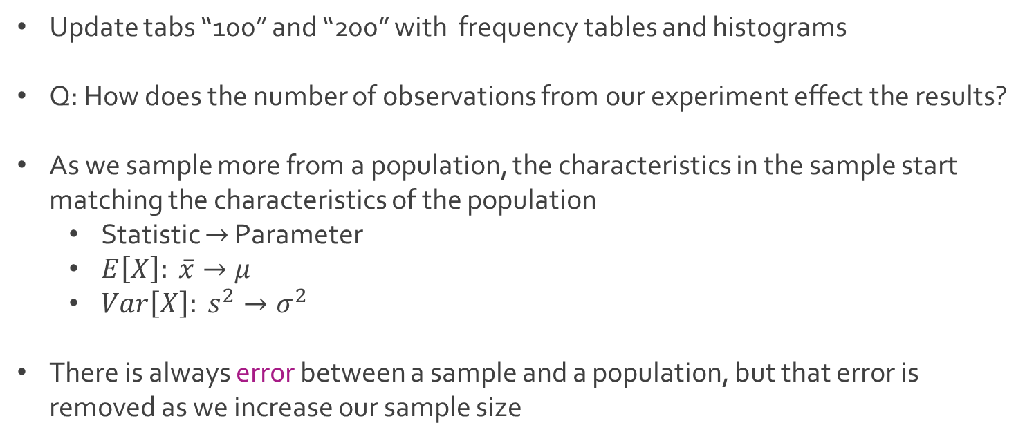
Ex: Sum of Dice
Update tabs “100” and “200” with frequency tables and histograms
Q: How does the number of observations from our experiment effect the results?
As we sample more from a population, the characteristics in the sample start matching the characteristics of the population
Statistic $→$ Parameter
$E\left[X\right]: \overline{x}→μ$
${Var\left[X\right]: s}^{2}→σ^{2}$
There is always error between a sample and a population, but that error is removed as we increase our sample size

Slide 12
Descriptive Statistics
Current methods are appropriate for univariate data
Bivariate data contains observations from a pair of variables
For bivariate data, the focus shifts to understanding the relationship between the two variables
Descriptive statistics for bivariate data
Scatterplot
Covariance
Correlation
Since the most widely used method for modeling relationships is linear regression, the scatterplot is often use to inspect if a linear relationship exists

Slide 13
Ex: Sum of Dice
Q: What kind of relationship exists between the outcomes of the two dice?
Q: What kind of relationship exists between the outcome of the second die and the sum of the two dice?
In Excel, create a scatterplot by using the Insert menu
Optionally, use Recommended Charts to help you select Scatter
Take a moment to create scatterplots to capture both relationships on the tab named “200”
Examine plots in tab named “50” and “100” for examples
Investigate the plots to determine if your hypotheses were true

Slide 14
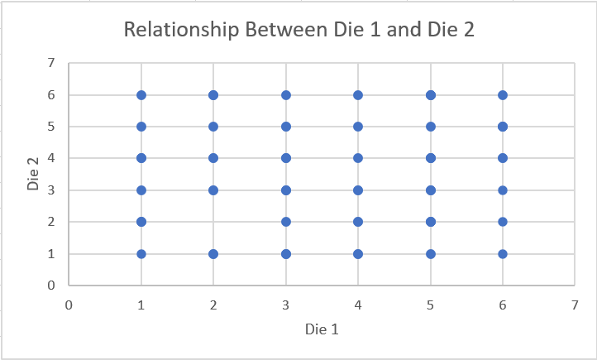
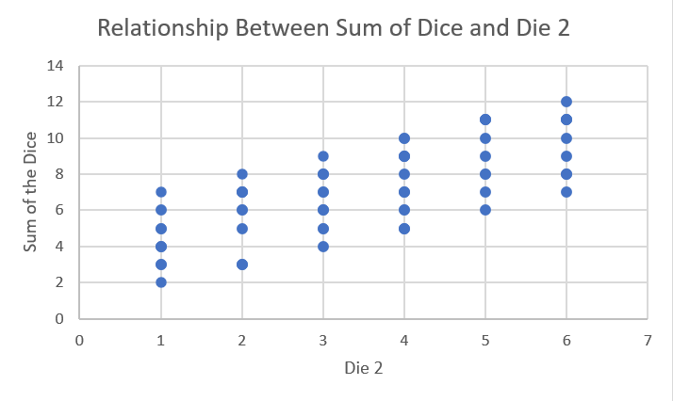
Ex: Sum of Dice
Plots based on 100 observations from the population
Q: How would we quantify the difference between these relationships?

Slide 15
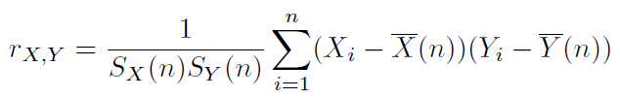
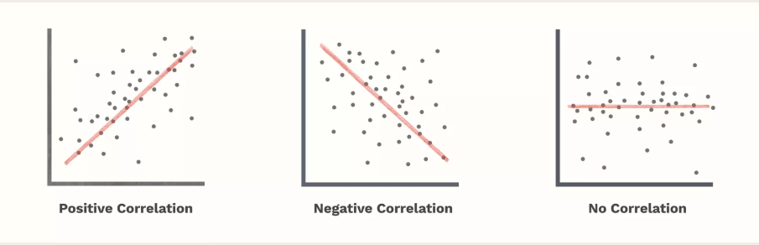
Descriptive Statistics
The sample correlation coefficient measures the strength of linear relationship between two variables on a scale between -1 and +1
Close to 1 implies strong positive correlation
Close to -1 implies strong negative correlation
Close to 0 indicates no correlation
Formula

Slide 16



Ex: Sum of Dice
Calculation of correlation using CORREL(variable 1, variable 2)
When n=50
When n=100
When n=200

Slide 17




The End
Dale

